Slide 1
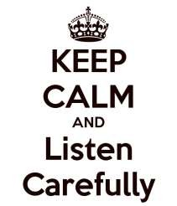
1
“If your actions inspire others to dream more, learn more, do more and become more, you are a leader..”

Slide 2
Leadership...
2

Slide 3
Contents Of The Presentation
Leadership -Meaning And Definition
Leadership And Management Leadership Styles
Theories Of Leadership Emerging Approaches To Leadership
3

Slide 4
Defining a Leader…
4
Think of a leader that you worked for or observed…
What does this person do
and what qualities this person have
does that
make you admire him or her as a leader?

Slide 5
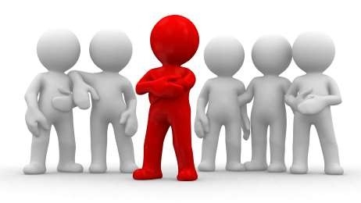
Person
5
Is leadership a position of office or authority?
Or,
Is leadership an ability in the sense that he is a leader because he leads?

Slide 6
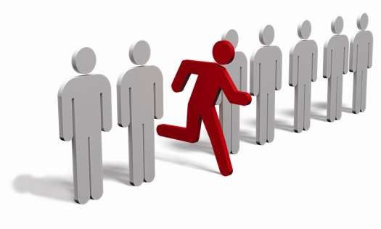
No…
6
A leader by its meaning is one who goes first and leads by example, so that others are motivated to follow him.
To be a leader, a person must have a deep-rooted commitment to the goal that he will strive to achieve it even if nobody follows him!

Slide 7
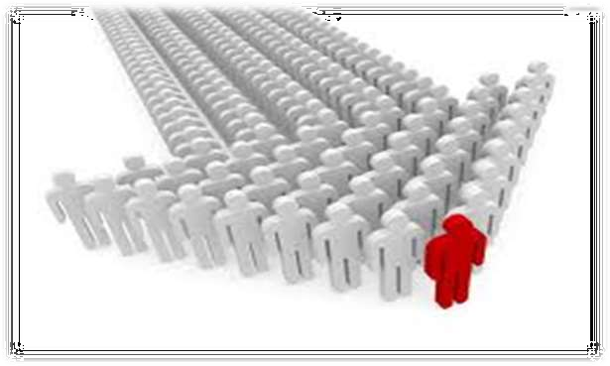
Who is a leader ?
7
a person who influences a group of people towards the achievement of a goal
“A leader is one who knows the way, goes the way, and shows the way.”
- John C. Maxwell

Slide 8
L E A D E R
EARN TO BE STRONG
MPOWER PEOPLE
SK QUESTIONS
ELEGATE
XAMPLE SETTER
EWARD & RECOGNIZE
8

Slide 9
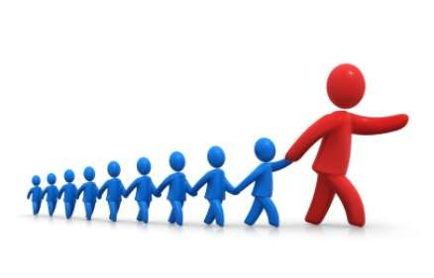
Meaning of Leadership
9
Leadership is the art of motivating a group of people to act towards achieving a common goal.
The process of encouraging and helping others to work enthusiastically towards objectives .

Slide 10
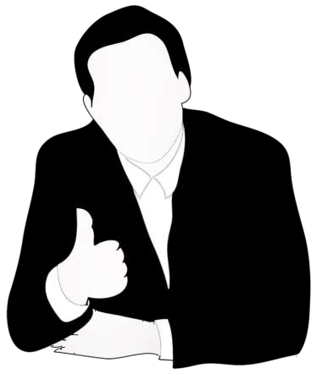
Definition of Leadership
10
Alan Keith stated that,
"Leadership is ultimately about creating a way for people to contribute to making something extraordinary happen.”
Koontz and O'Donnell :-
“Leadership maybe defined as the ability to exert interpersonal influence by means of communication towards the achievement of a goal.”

Slide 11
The essence of leadership
11
▶ Leadership refers to ability of one individual to influence others.
▶ The influence is exercised to change the behaviour of others.
▶ Change of behaviour is caused with an objective of achieving a shared goal.
▶ The person influencing others(leader) possesses a set of qualities or characteristics with which he or she to influence others
▶ Leadership is a group phenomenon. It involves interaction between two or more people.

Slide 12
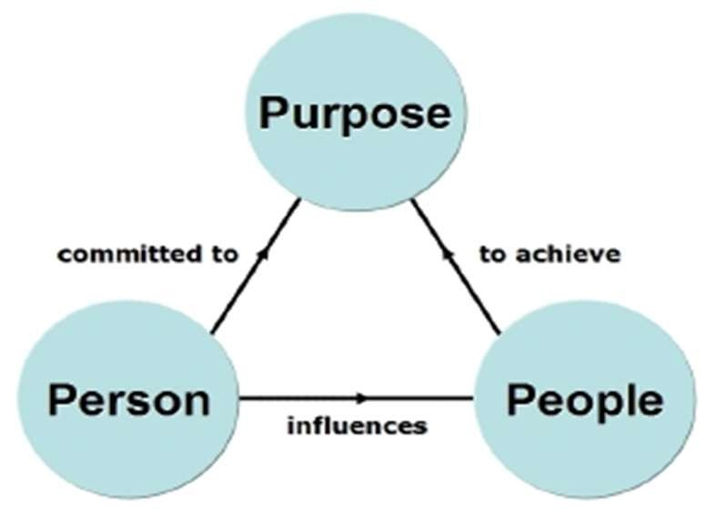
A mnemonic for leadership would be 3P's - Person, People and Purpose
12

Slide 13
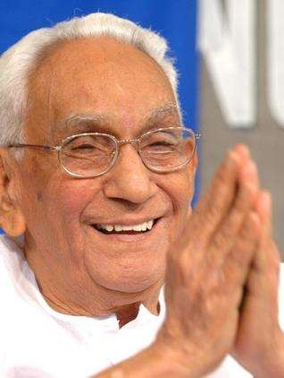
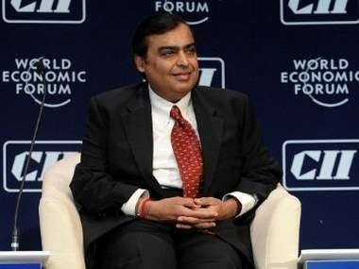
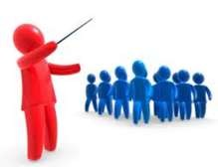
Leadership & Management
13
K Karunakaran
Mukesh Ambani

Slide 14
A Question…
14
A leader need not be a manager but a manager must have many of the qualities of a
good leader?
What do you think ?

Slide 15
Difference between Managers & Leaders
15
MANAGERS | LEADERS
Administer | Innovate
Maintain | Develop
Control | Inspire
Short term view | Long term view
Ask how & when | Ask what & why
Initiate | Originate
Accept the status quo | Challenge the status quo
Do things right | Do right things.

Slide 16
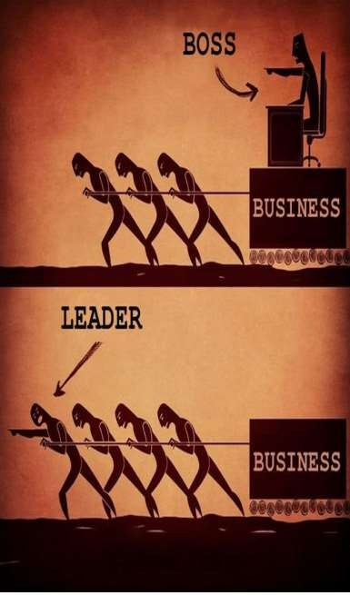
Leadership & Management ¹⁶
Management - is a process of planning
,organising, coordinating ,directing, and controlling the activities of others.
Leadership - is the process of influencing for the purpose of achieving shared goals
▶ Leadership and management are related, but they are not the same.
▶ Organizations need both leadership and management if they are to be effective.
▶ Leadership is necessary to create change; management is necessary to achieve orderly results.

Slide 17
Leadership
17
Management
Working in the system
React
Control risks
Enforce organizational rules
Seek and then follow direction
Control people by pushing them in the right direction
Coordinate effort
Provide instructions
Working on the system
Create opportunities
Seek opportunities
Change organizational rules
Provide a vision to believe in and
strategic alignment
Motivate people by satisfying basic human needs
Inspire achievement and energize
people
Coach followers, create self- leaders and empower them

Slide 18
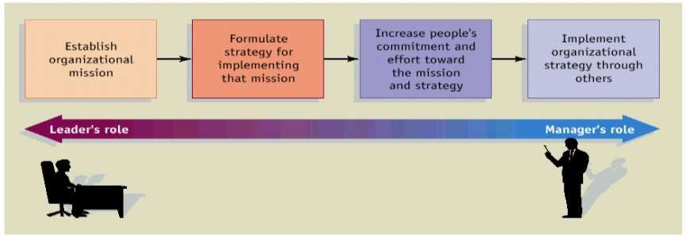
18

Slide 19
Formal & informal leadership
19
Formal leadership
Occurs when a manager leads by exercising formal authority. The exercise of formal authority through assigning duties derives, from the managers official position within the organisation’s hierarchy of authority. Any employee who is assigned a managerial position has the opportunity and responsibility to exercise formal leadership
Informal leadership
Arises when a person without formal authority is influential in directing the behavior's of others. Although not formally appointed or elected he becomes a leader through his actions or personal attractions.

Slide 20
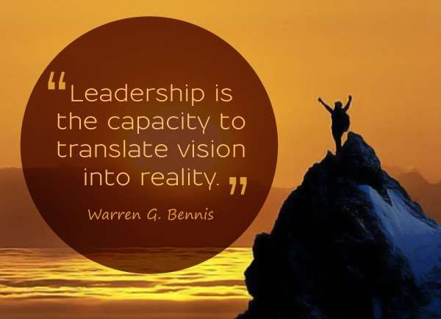
Significance of leadership
20
Initiates action
Motivation
Providing guidance
Creating confidence
Building morale
Developing Team-work
Co-ordination
Facilitates Change
Representing the group

Slide 21
Leadership Styles
21
A leadership style is a leader's style of providing direction, implementing plans, and motivating people

Slide 22
Based on authority retained
Based on task versus people emphasis
Based on assumptions about people
Likert’s four styles
Entrepreneurship leadership styles.
22

Slide 23
1. Based on authority retained
23
Also known as Lewin’s Leadership styles. In 1939, a group of researchers led by psychologist Kurt Lewin set out to identify different styles of leadership.
Based on Authority retained
Authoritarian
Democratic
Free rain (lassie Faire)
Consultative
Persuasive

Slide 24
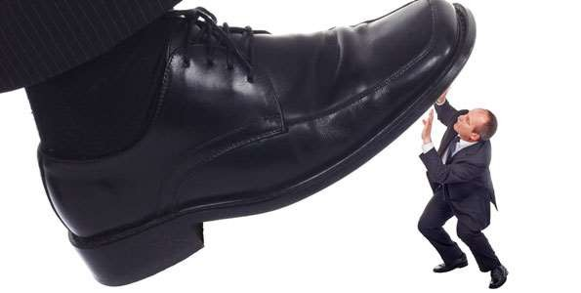
Autocratic or authoritarian style
24
Under the autocratic leadership style, all decision-making powers are centralized in the leader, as with dictator leaders.
They do not entertain any suggestions or initiatives from subordinates. The autocratic management has been successful as it provides strong motivation to the manager.
It permits quick decision-making, as only one person decides for the whole group and keeps each decision to himself until he feels it is needed to be shared with the rest of the group.
High degree of
the leader
May be valuable in some types of business where decisions need to be made quickly and decisively
dependency on

Slide 25
Participative or democratic style
25
The democratic leadership style favours decision-making by the group .
They can win the cooperation of their group and can motivate them
effectively and positively.
The decisions of the democratic leader are not unilateral as with the autocrat because they arise from consultation with the group members and participation by them.
Consultative
: process of consultation before decisions are taken
: Leader takes decision and seeks to persuade others that the decision is correct
Persuasive

Slide 26
Laissez –Faire or free rein style
26
A free rein leader does not lead, but leaves the group entirely to itself such a leader allows maximum freedom to subordinates, i.e. they are given a free hand in deciding their own policies and methods.
Can be very useful in businesses where creative ideas are important
Can be highly motivational, as people have control over their working life
Can make coordination and decision making time-consuming and
lacking in overall direction
Relies on good team work.
Relies on good interpersonal relations.

Slide 27
2. Based on task versus people Emphasis
27
High
High relationship and low-task [ supporting style ] | High task and high relationship [ participative style]
Low-task and low relationship [ free rein style ] | High task and low relationship [ autocratic style ]
People Emphasis
Low
Low
High
Task Emphasis

Slide 28
3. Based on assumptions about people
28

Slide 29
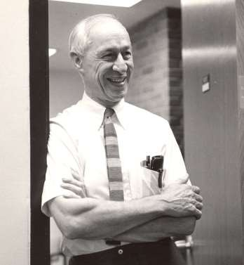
4.Likert’s four system approach²⁹
Benevolent authoritarian
Consultative
Exploitative authoritarian
Participative
Rensis Likert 1903 - 1981

Slide 30
▶ System 1 - Exploitative Authoritative: Responsibility lies in
30
the hands of the people at the upper echelons of the hierarchy. The superior has no trust and confidence in subordinates. The decisions are imposed on subordinates and they do not feel free at all to discuss things about the job with their superior. The teamwork or communication is very little and the motivation is based on threats.
▶ System 2 - Benevolent Authoritative: The responsibility lies at the managerial levels but not at the lower levels of the organizational hierarchy. The superior has condescending confidence and trust in subordinates (master-servant relationship). Here again, the subordinates do not feel free to discuss things about the job with their superior. The teamwork or communication is very little and motivation is based on a system of rewards.

Slide 31
▶ System 3 - Consultative: Responsibility is spread widely through
31
the organizational hierarchy. The superior has substantial but not complete confidence in subordinates. Some amount of discussion about job related things takes place between the superior and subordinates. There is a fair amount of teamwork, and communication takes place vertically and horizontally. The motivation is based on rewards and involvement in the job.
▶ System 4 - Participative: Responsibility for achieving the organizational goals is widespread throughout the organizational hierarchy. There is a high level of confidence that the superior has in his subordinates. There is a high level of teamwork, communication, and participation.

Slide 32
5. Entrepreneurship leadership style 32
▶ A heavy task orientation combined with a very direct-approach to giving instructions to employees.
▶ A charismatic personality that inspires others to do business with him.
▶ A much stronger interest in dealing with
customers than employees.
▶ A strong dislike for bureaucratic rules and regulations.
▶ Anxiety to consolidate business gains as quickly as possible

Slide 33
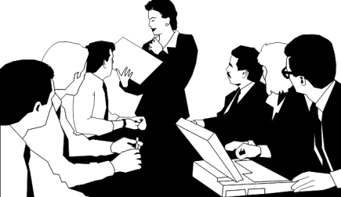
Others Leadership Styles
33
Bureaucratic
Coercive
Paternalistic
Transactional
Transformational

Slide 34
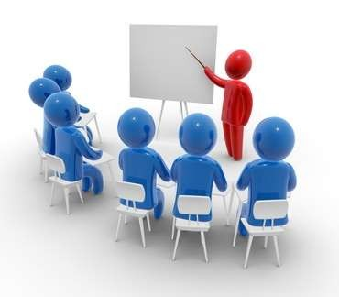
Bureaucratic
34
▶ Manager
manages “by the
book¨
▶ Everything must be done according to procedure or policy
▶ If it isn’t covered by the book, the manager refers to the next level above him or her
▶ Police officer more than leader

Slide 35
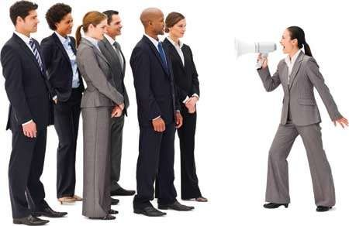
Coercive
35
▶ Power from a person’s authority to punish
▶ Most obvious types of power a leader has.
▶ Good leaders use coercive power only as a last resort

Slide 36
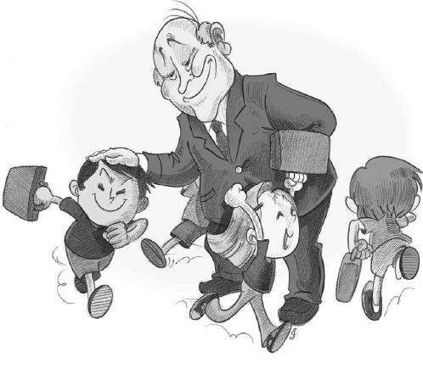
Paternalistic
36
▶ Leader acts as a ‘father figure’
▶ Paternalistic leader makes decision but may consult
▶ Believes in the need to support staff

Slide 37
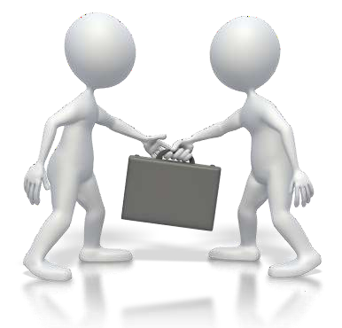
Transactional
37
Motivate followers by appealing to their own self-interest
Motivate by the exchange process.
EX: business owners exchange status and wages for the work effort of the employee.
Focuses on the accomplishment
of tasks
& good worker in exchange for
relationships
desirable rewards.
Encourage leader to adapt their
style and behavior to meet expectations of followers

Slide 38
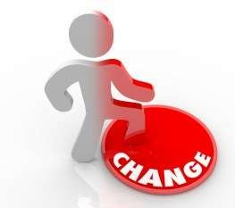
Transformational
38
▶ Charismatic and visionary
▶ Inspire followers to transcend their self-interest for the organization
▶ Appeal to followers' ideals and values
▶ Inspire followers to think about problems in new or different ways
▶ Common strategies used to influence followers include vision and framing
▶ Instills feelings of confidence, admiration and commitment
▶ Stimulates followers intellectually, arousing them
to develop new ways to think about problems.
▶ Uses contingent rewards to positively reinforce
desirable performances
▶ Flexible and innovative

Slide 39
Factors affecting leadership
39

Slide 40
Factors Affecting Style
40
Risk - decision making and change initiatives based on degree of risk involved
Type of business – creative business or supply driven?
How important change is – change for change’s sake?
Organisational culture – may be long embedded and difficult to change
Nature of the task – needing cooperation? Direction? Structure?

Slide 41
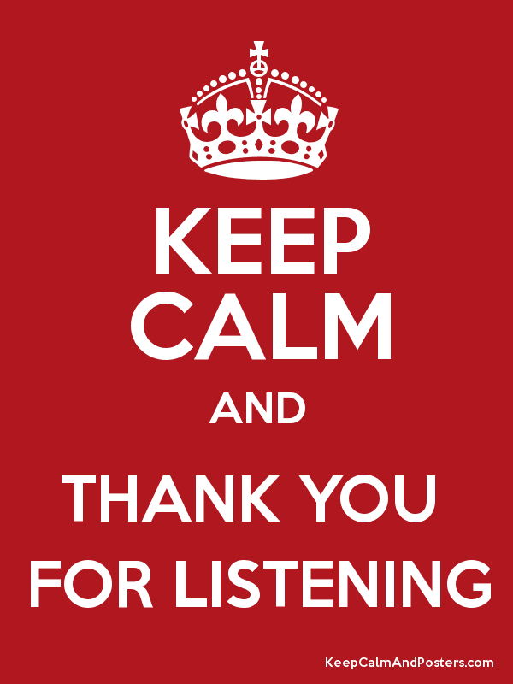
107

